Slide 1


Recommendation Engine for
Songs Music application.
.

Slide 2
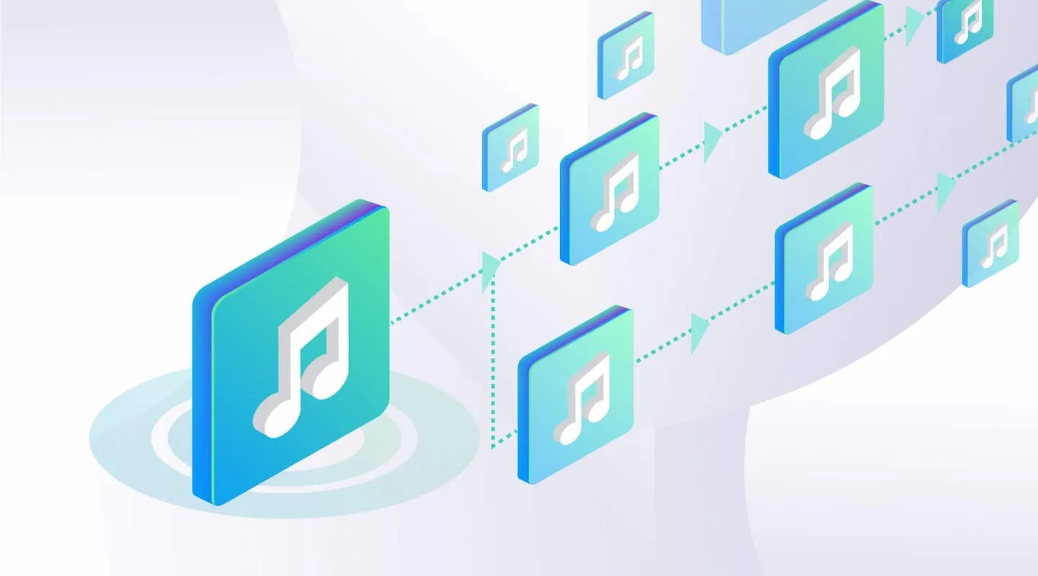
GROUP – 3
Mr. Konda Sai Madhav.
Mr. Kunal Ajit Shinde.
Ms. Amulya U Reddy.
Mr. Ketan Vasant Suroshe.
Mr. Clinton . S
Ms. Sangam Gladina.
Project Mentor: B.Pallavi.
Project Mentor: Syedasamreen Shahabujuruk.

Slide 3

Table Of Contents
Introduction
Business Problem
Data Overview
EDA
Model Building
Model deployment
Conclusion

Slide 4

Introduction
Business Problem:
The primary business problem for customers in music recommendation apps is often a lack of personalized recommendations, leading to frustration and disengagement. Customers desire diverse and accurate suggestions aligned with their individual tastes and moods. Without effective personalization users may struggle to discover new music they genuinely enjoy, impacting their overall satisfaction and retention. To address this, music apps must refine their recommendation algorithms.
Objective:
The primary focus of our business strategy is to enhance customer satisfaction and engagement within our music recommendation app. We aim to achieve this by improving the personalization of music recommendations, ensuring they align closely with individual preferences and moods. Main objective is to boost user retention by delivering diverse and accurate music suggestions to each user's unique tastes. To make this, we will optimize our recommendation algorithms to facilitate easy discovery of new music that resonates with our users.

Slide 5
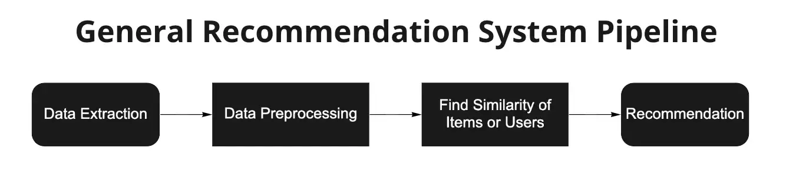
Project Architecture / Project Flow:
Dataset download
Meta Data:
One hot Encoding
Summarize features
Define Threshold
Spotify API Feature Recommended
Audio Normalization
Find Cosine Similarity Between Songs
Data Reshaping
Text Sentiment Analysis

Slide 6

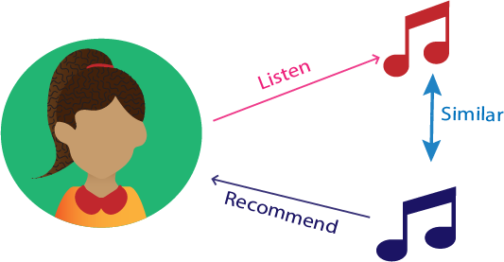
Data Overview:
Tools:
Pandas
Numpy
Matplolib
Seaborn
Sklearn
K-Means
PCA
TSNE
DBSCAN

Slide 7
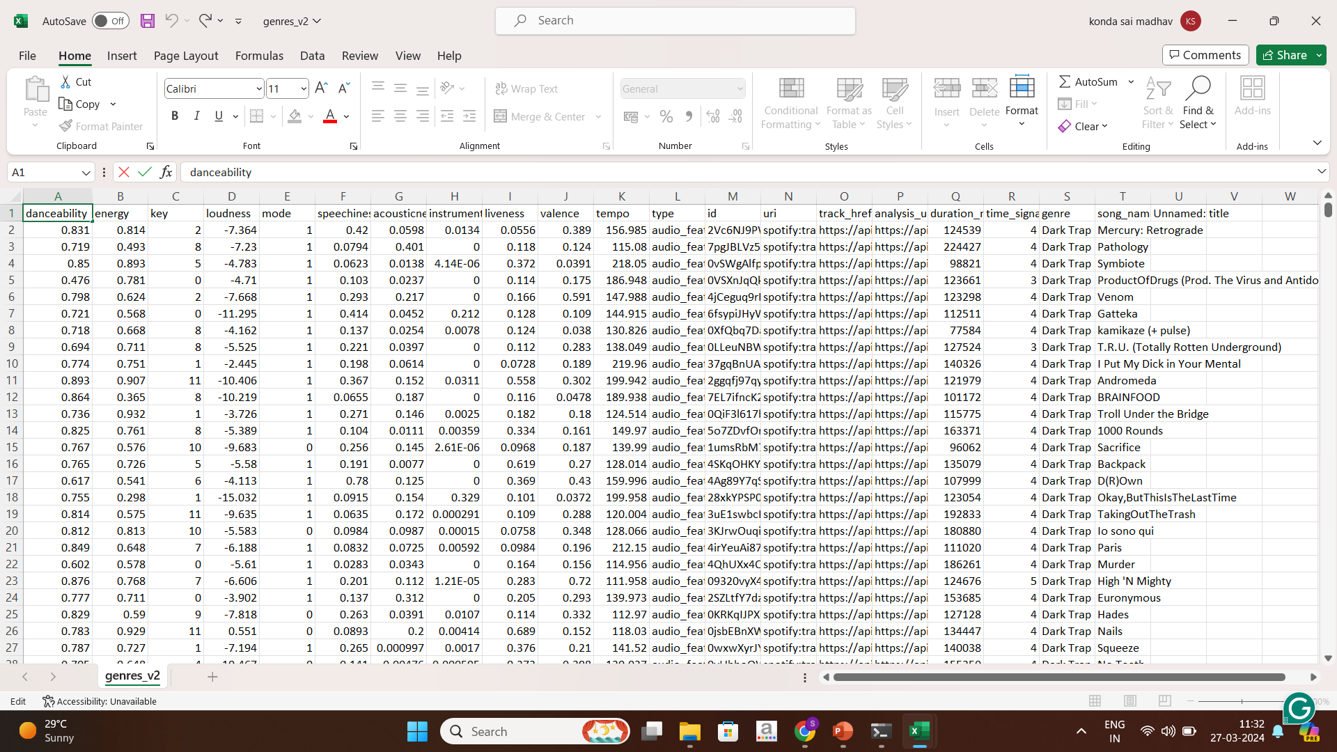
Data Overview:

Slide 8
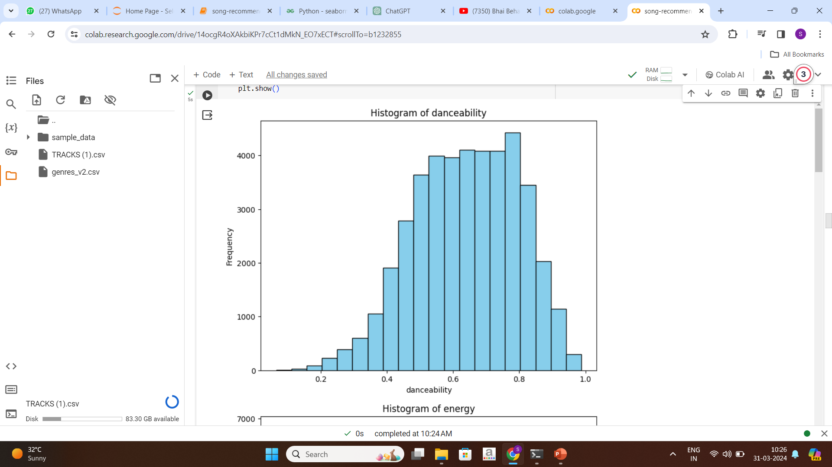
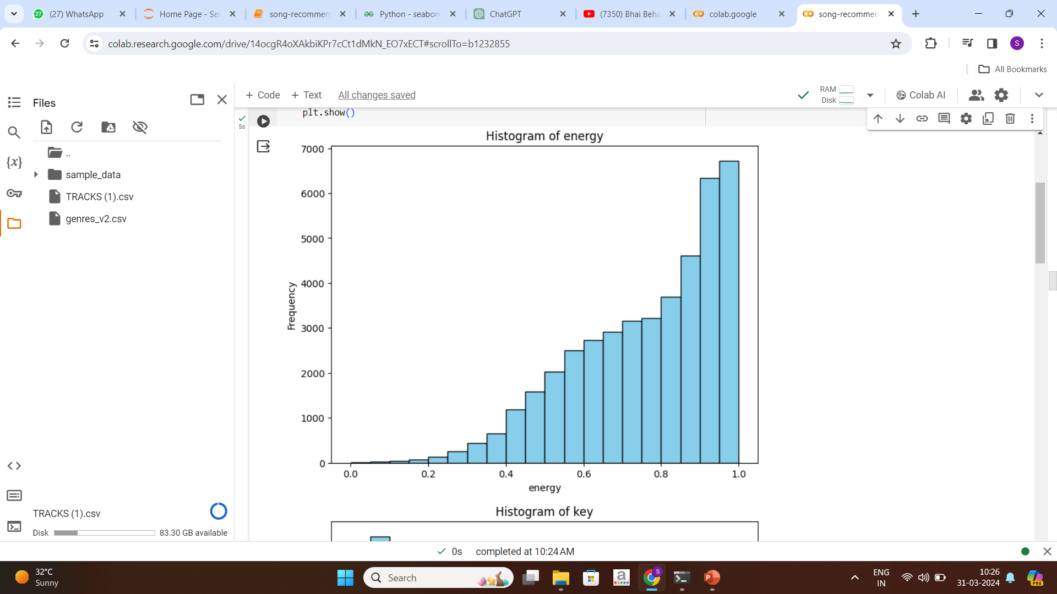
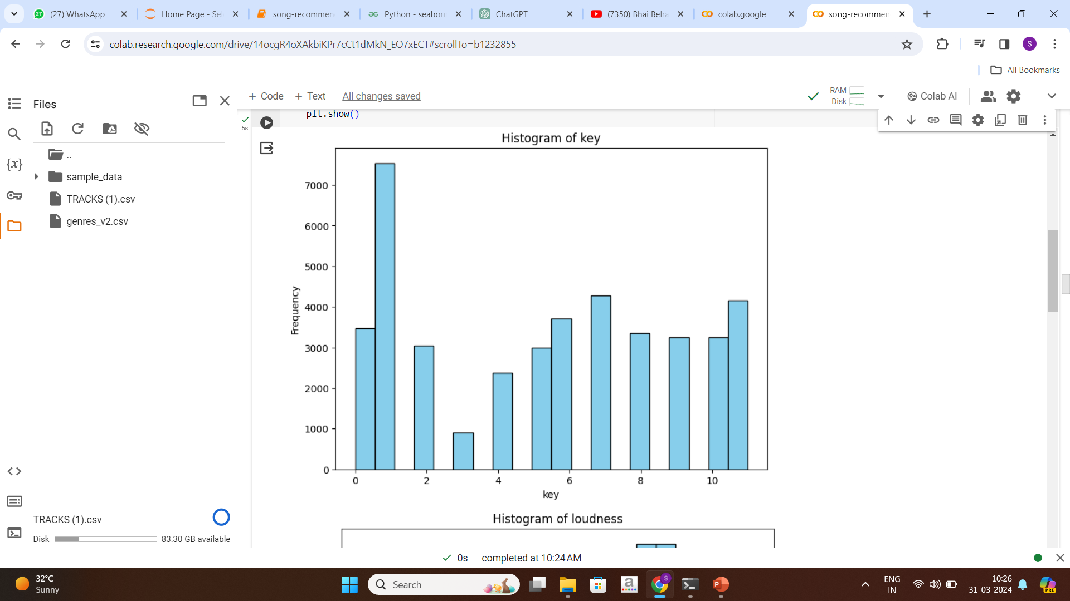
Exploratory Data Analysis (EDA) and
Feature Engineering
Exploratory Data Analysis (EDA) involves understanding the dataset’s patterns, characteristics and relationships through statistical and visual methods through histograms

Slide 9
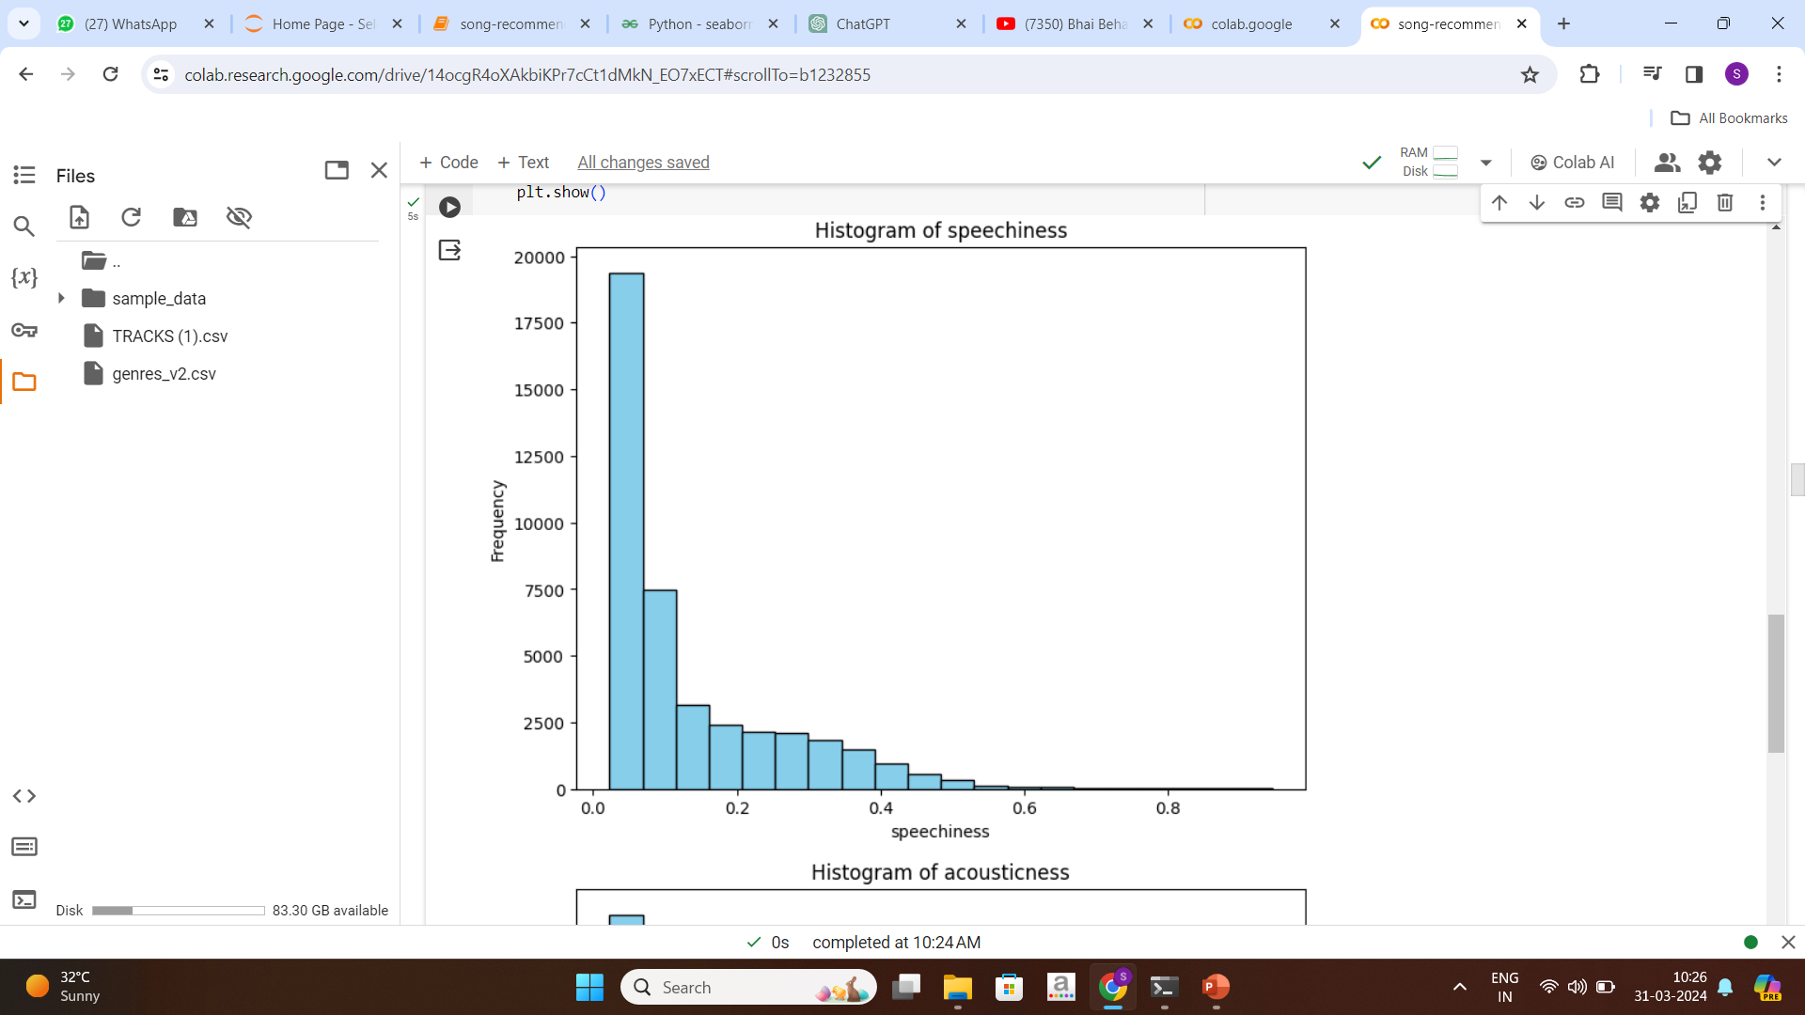
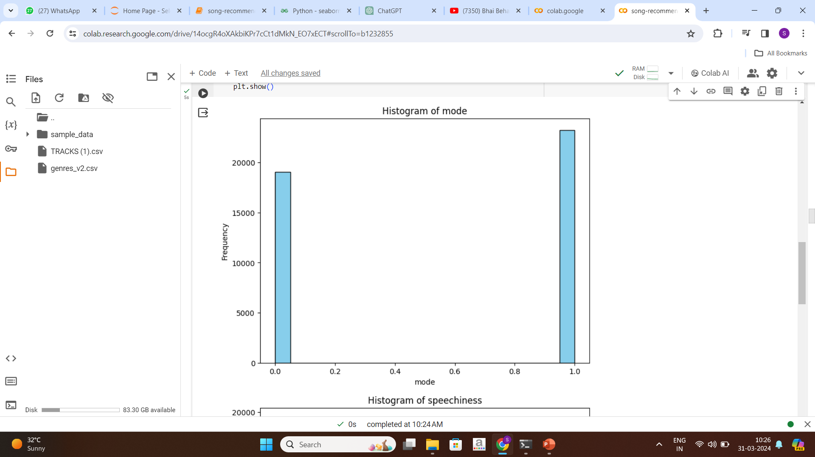
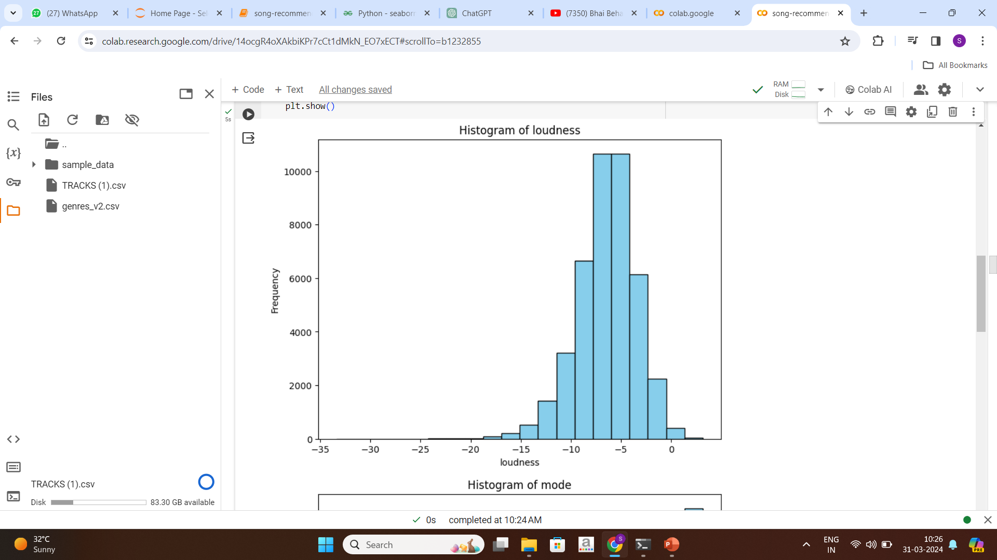
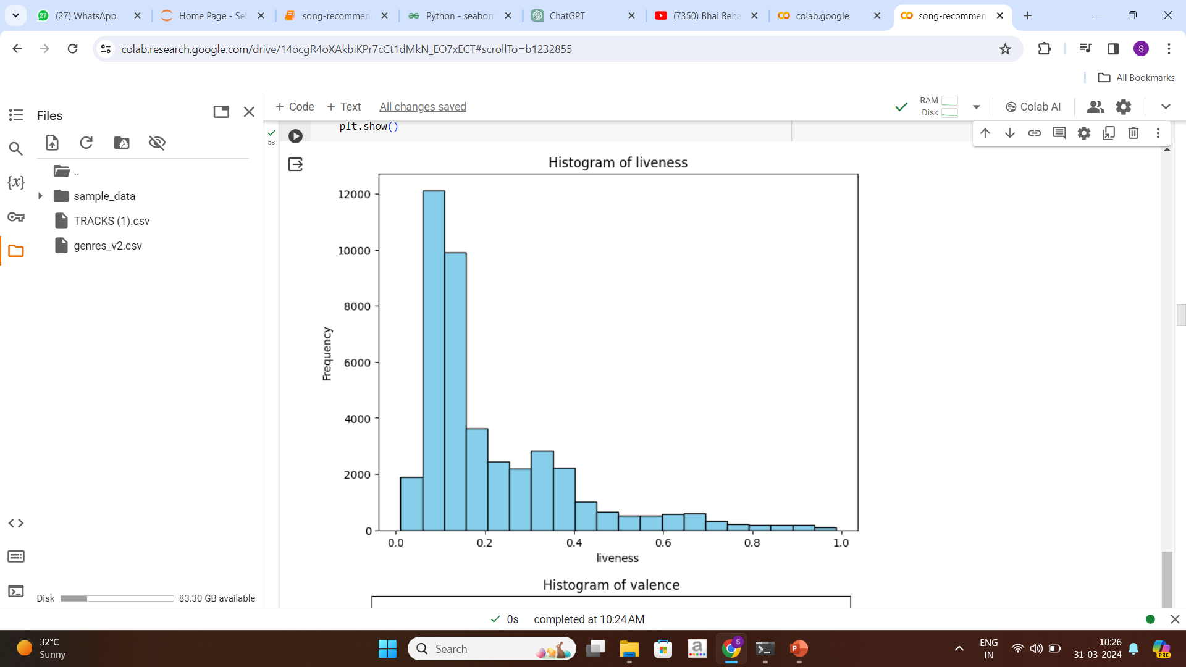
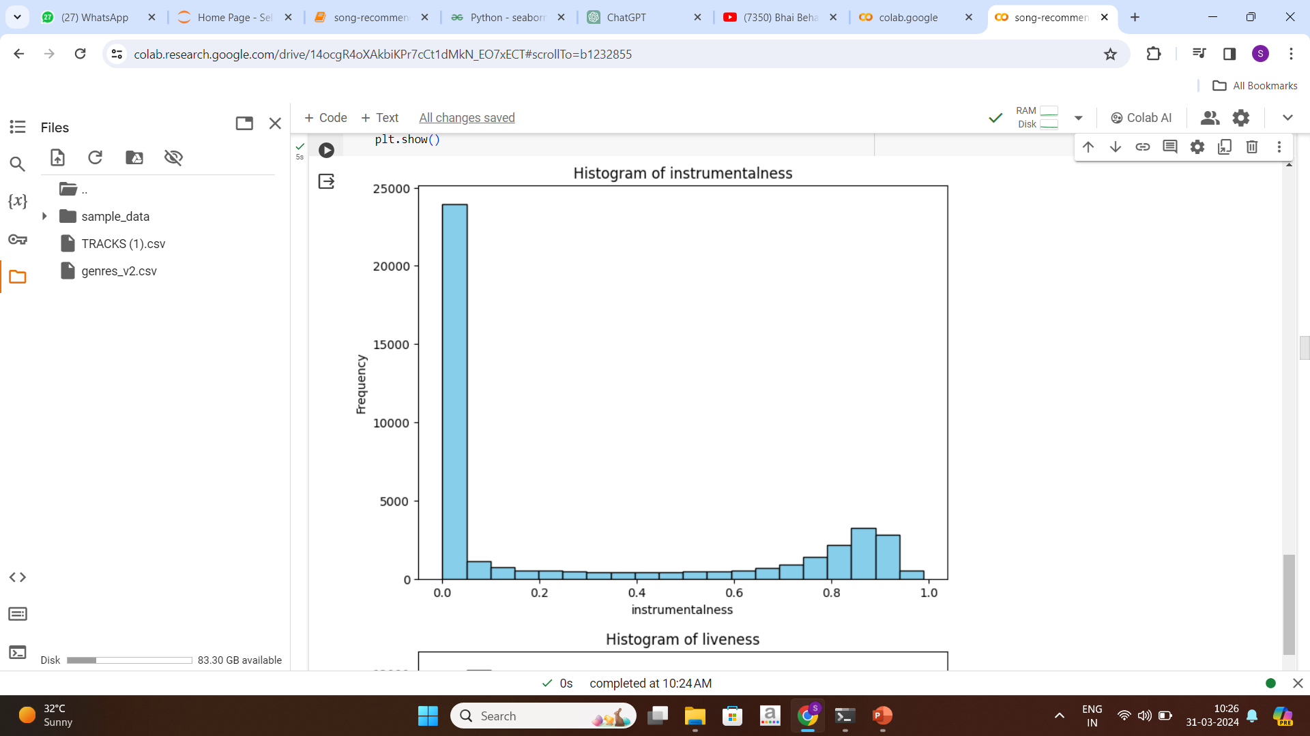
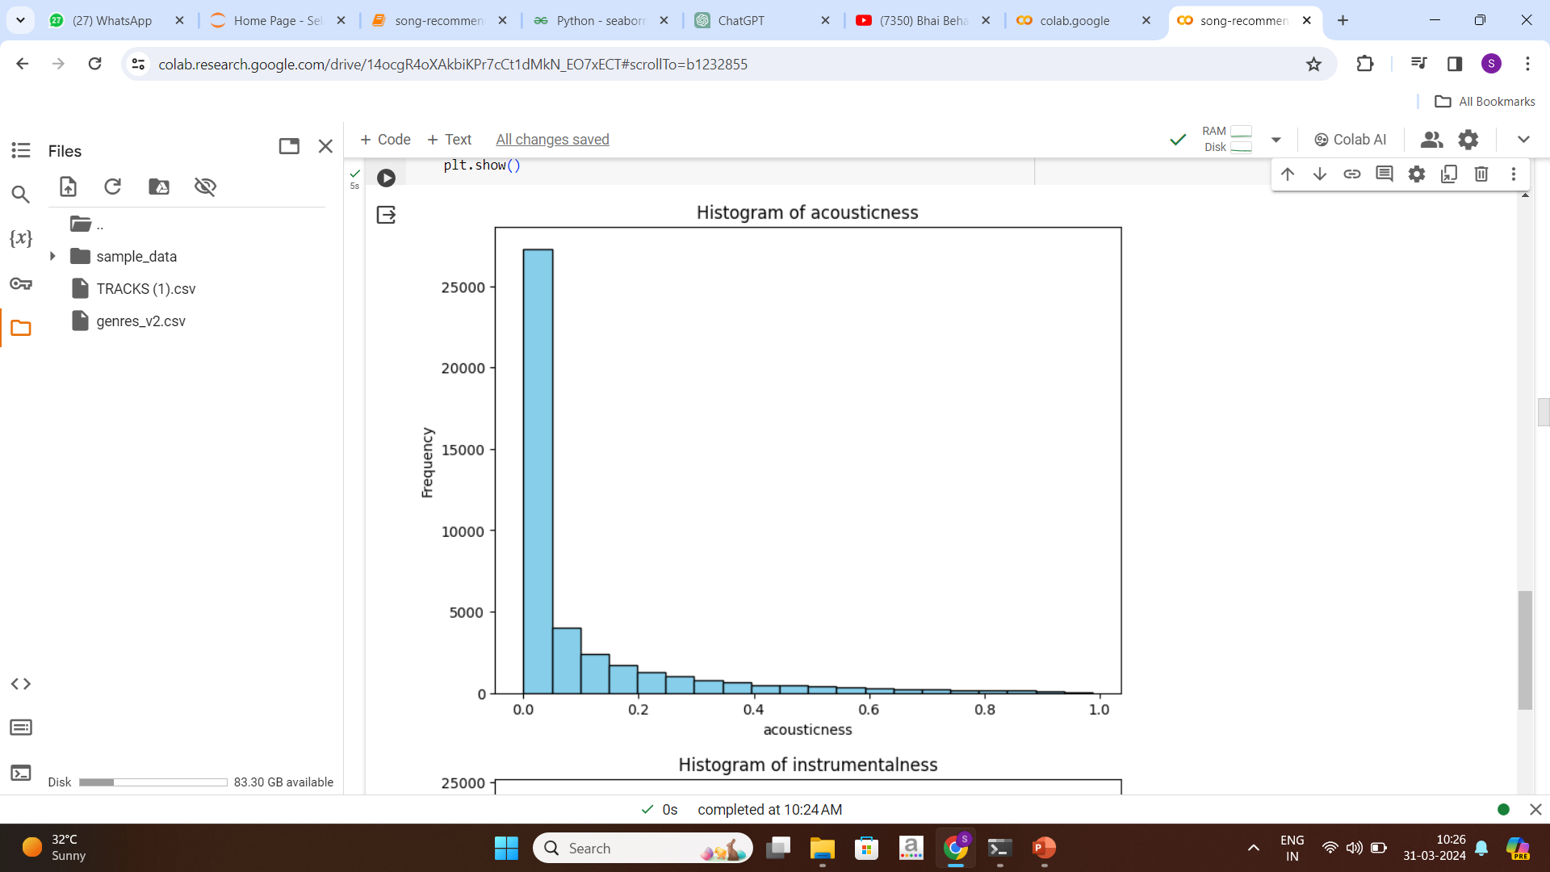
Exploratory Data Analysis (EDA) and
Feature Engineering

Slide 10
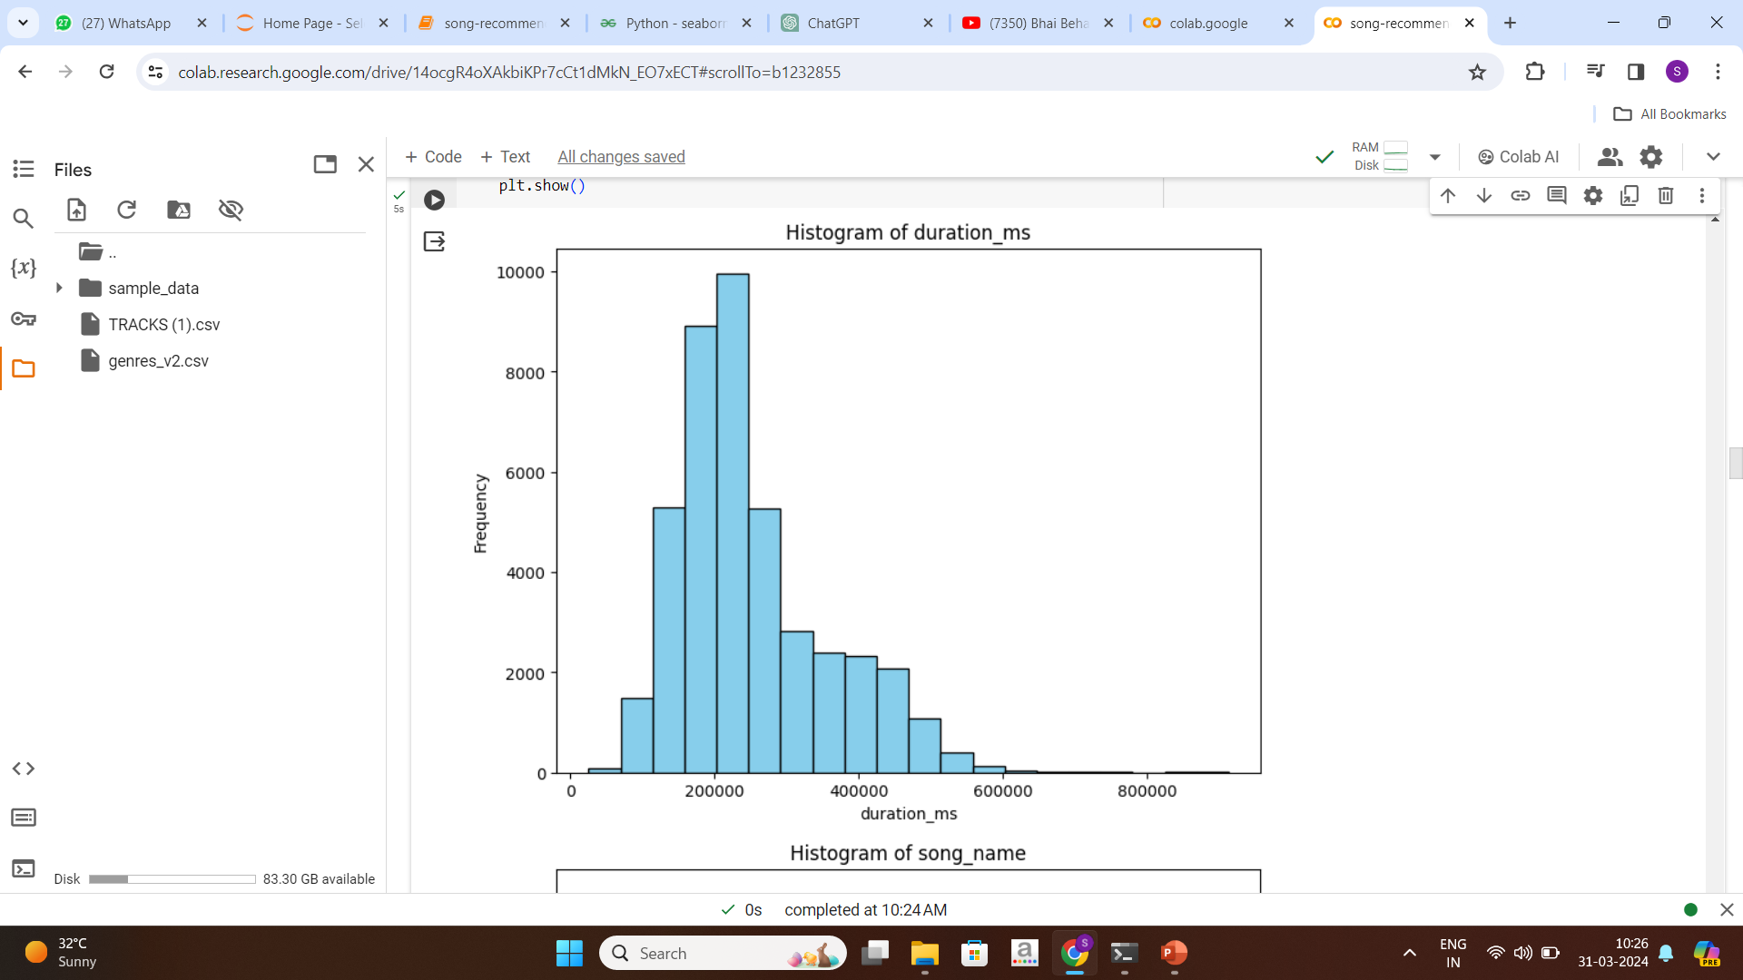
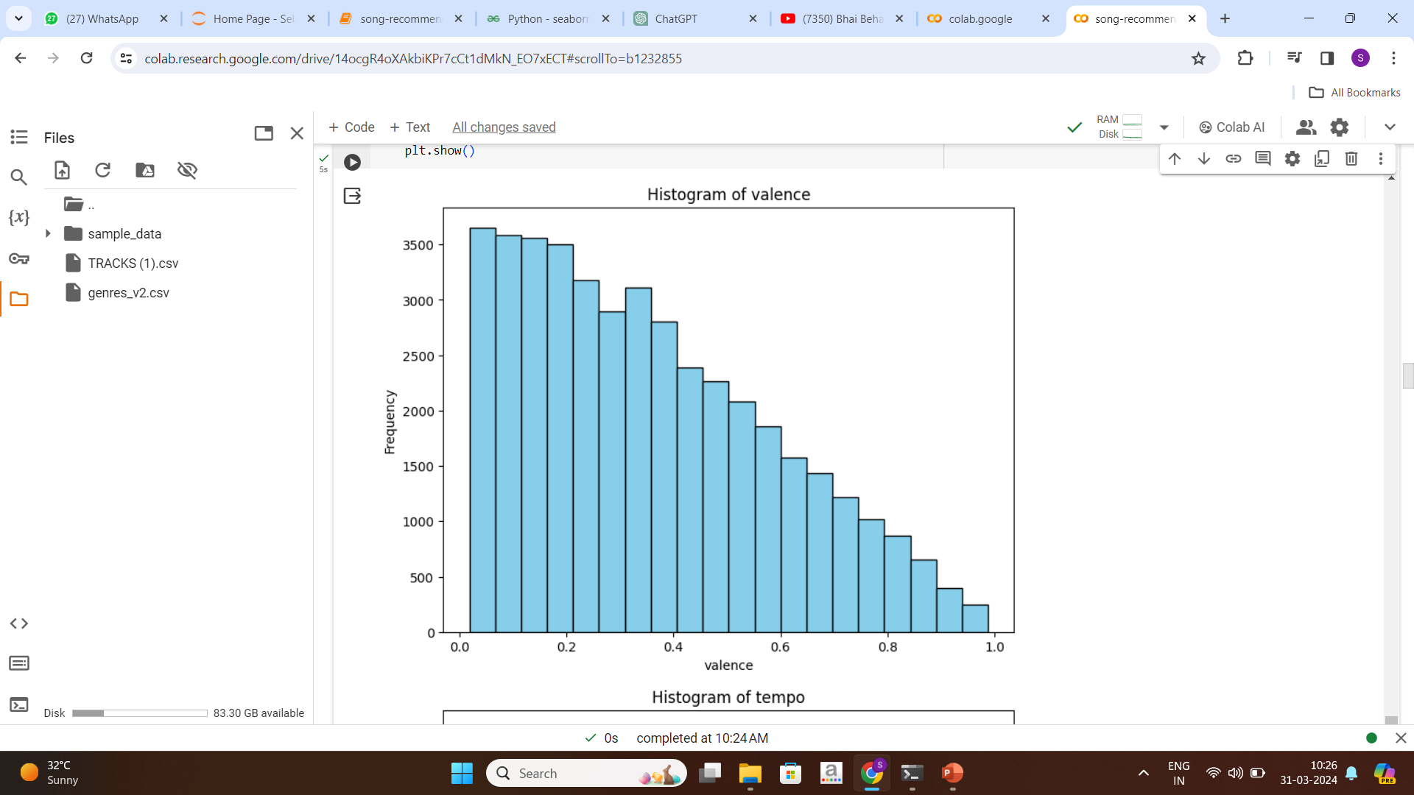
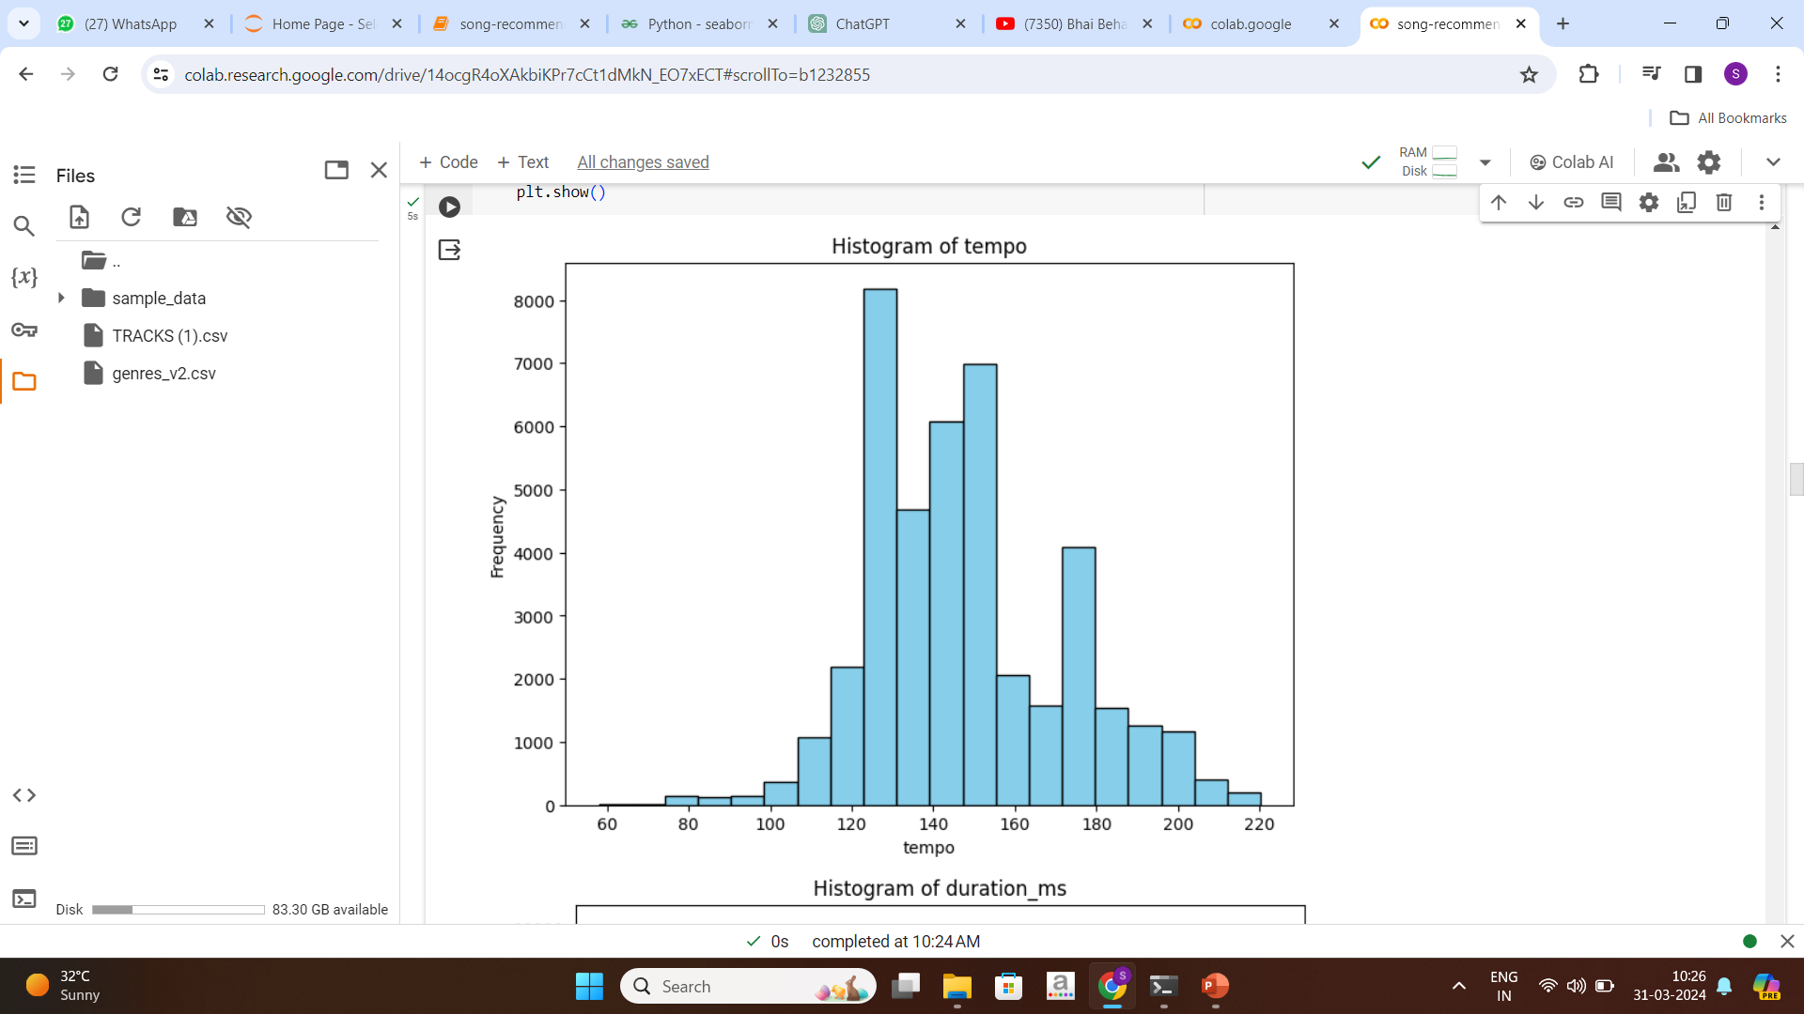
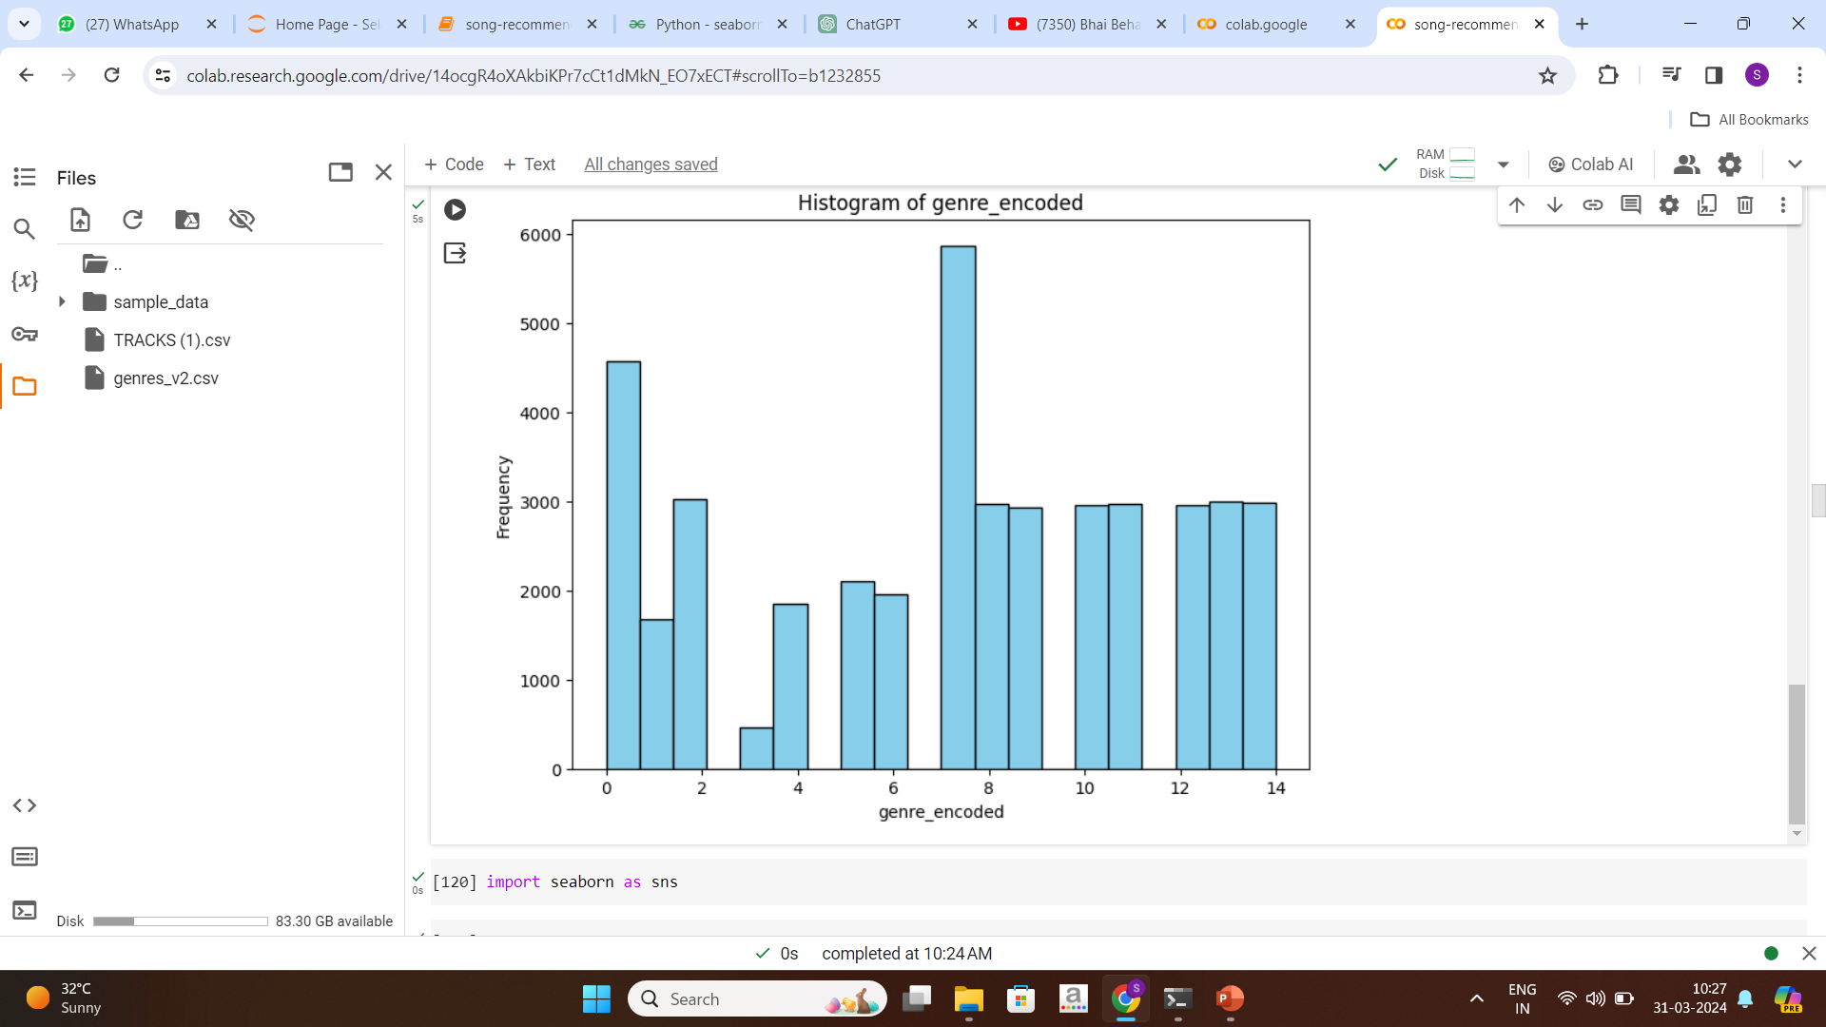
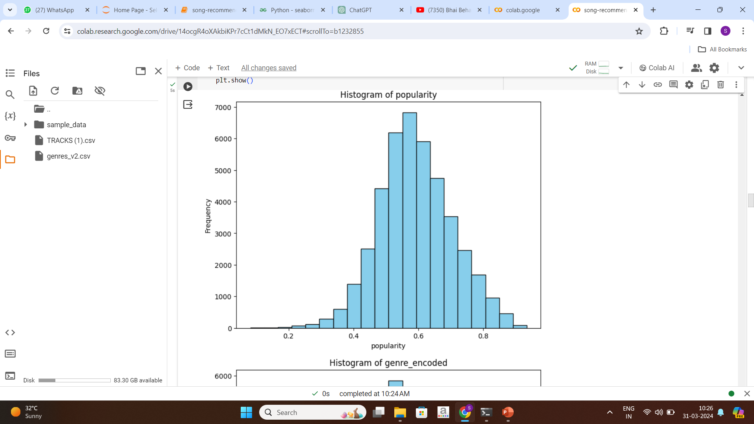
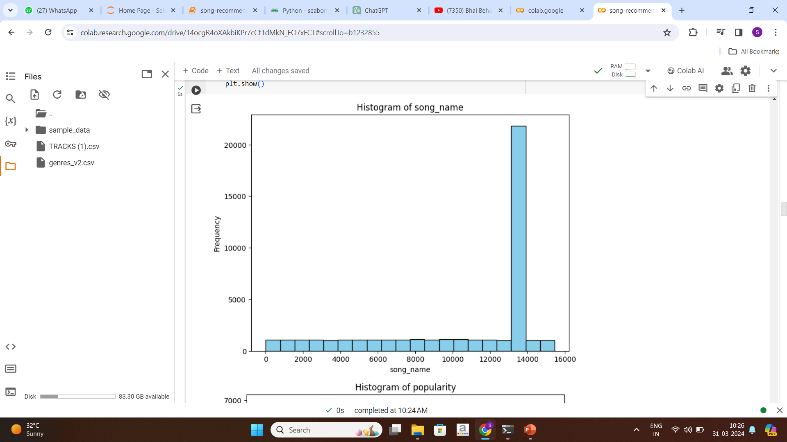
Exploratory Data Analysis (EDA) and
Feature Engineering

Slide 11
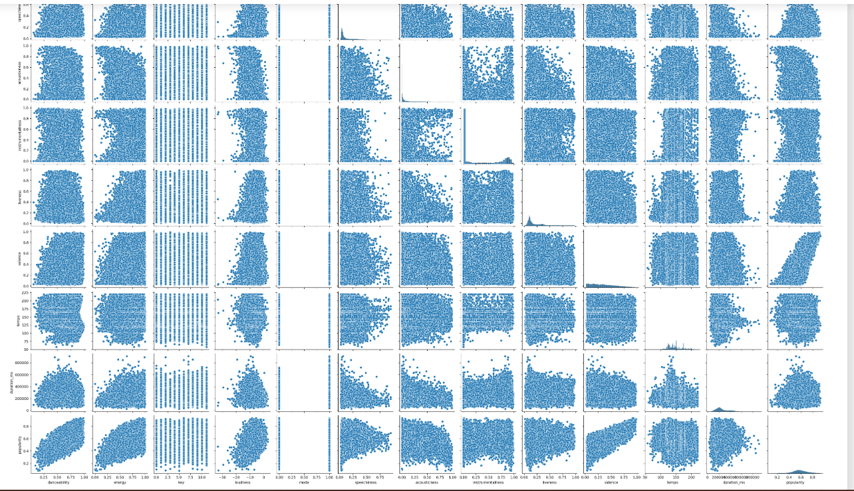
PAIR PLOT:
Pair plots provide a convenient and efficient way to visualize the relationships between multiple variables,Identifying Patterns and Trends and good diagnostic Tool for Data Exploration.

Slide 12
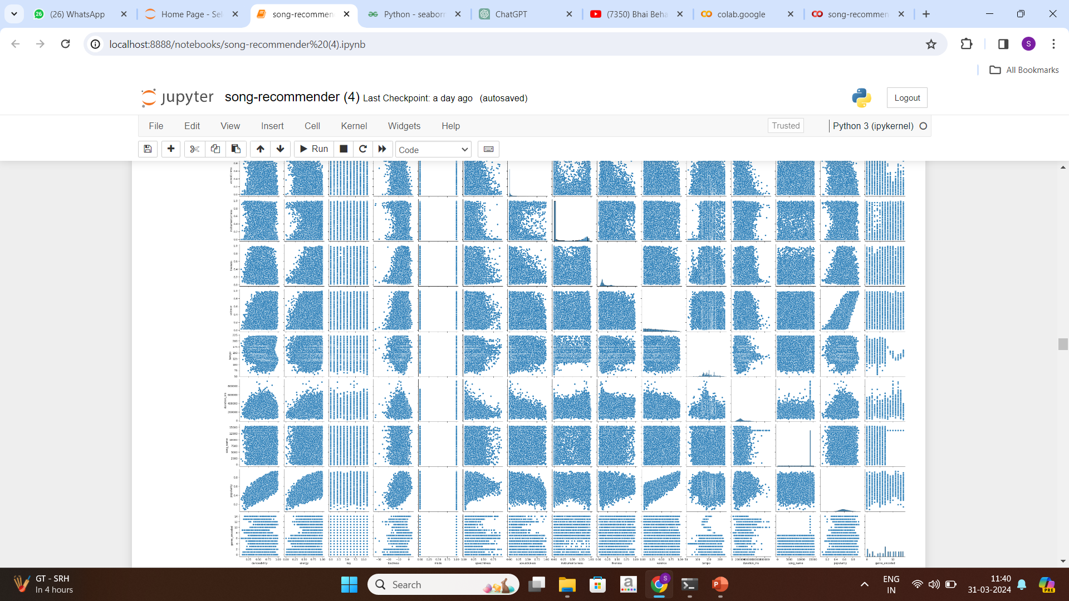
Pair Plot

Slide 13
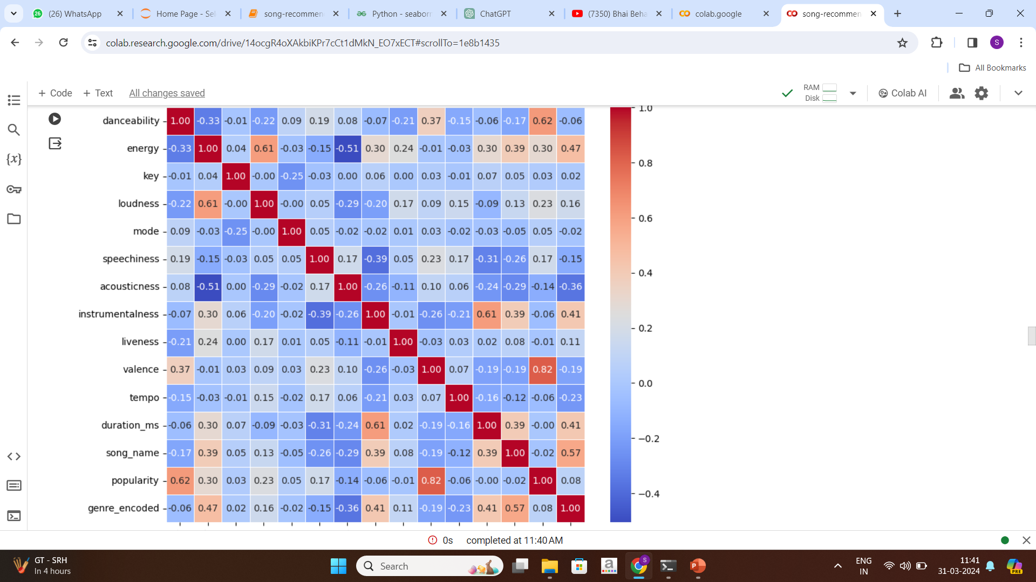
Exploratory Data Analysis (EDA)
The heat map shows the matrix of all the columns. By that, we can conclude the Correlation
analysis of each column how they are related to each one of them.

Slide 14
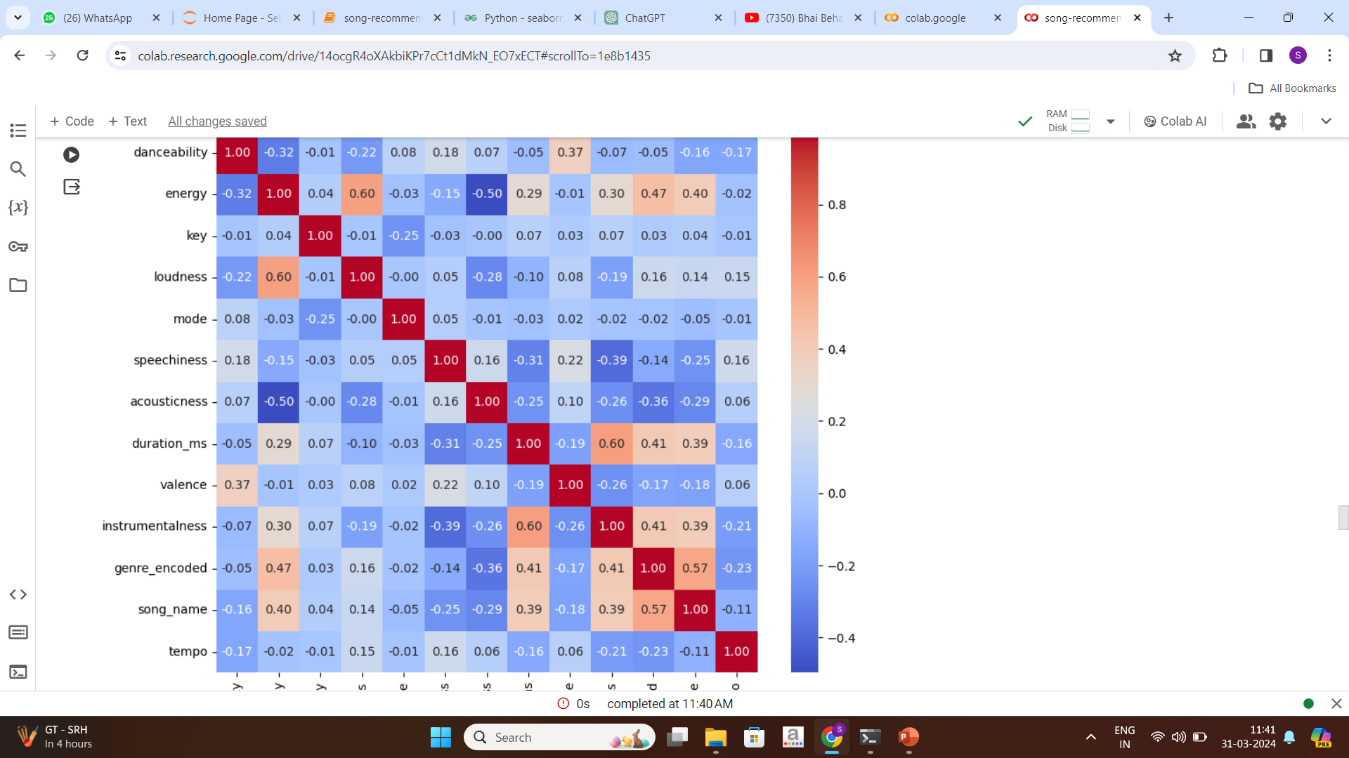
Exploratory Data Analysis (EDA)

Slide 15
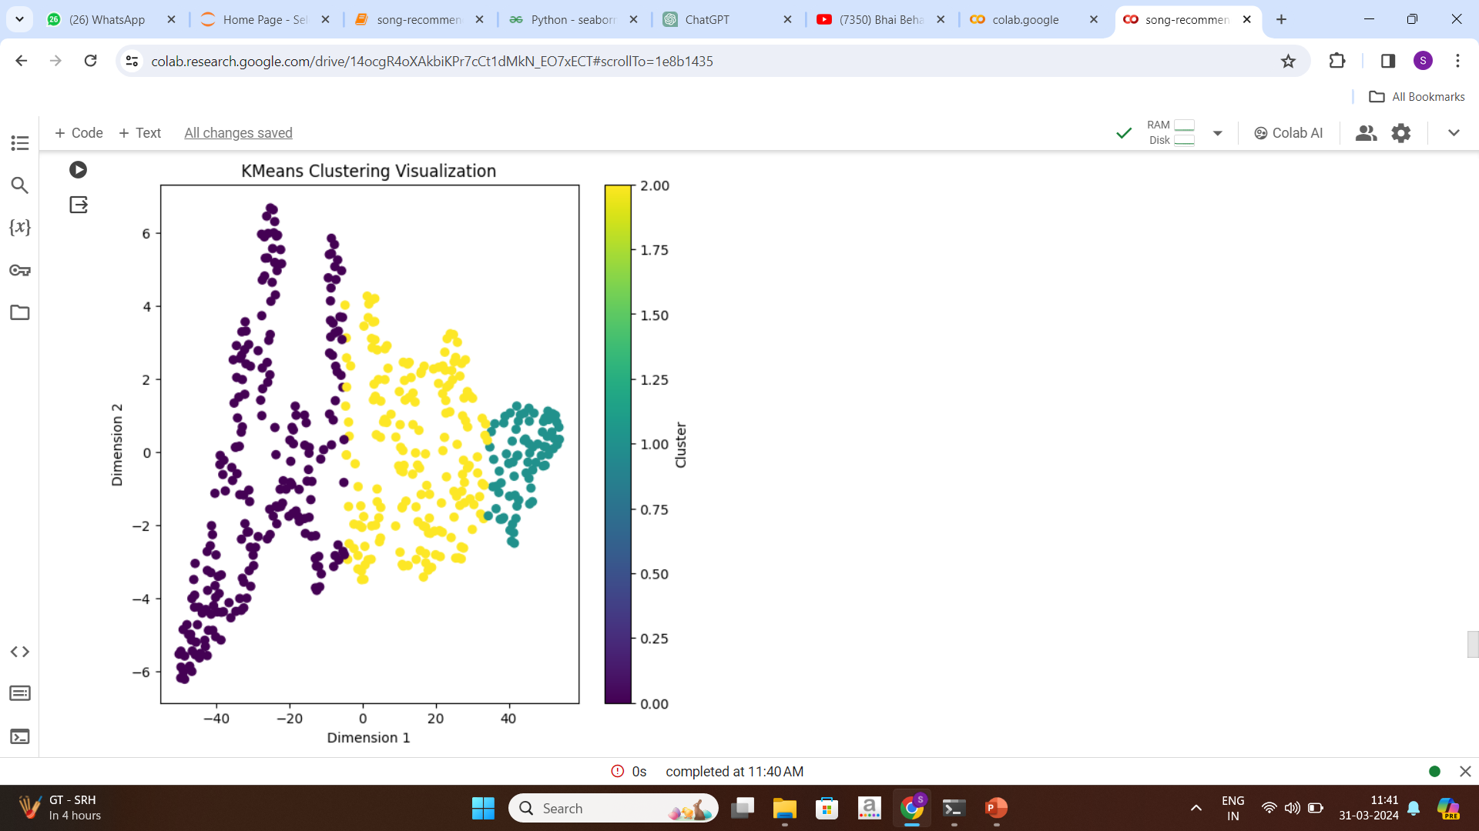
Model Building:
K-means:
In practical terms, for our musical dataset, k-means will analyze the different acoustic features (columns) for each of the songs, such as tempo, energy, pitch and many more and attempt to group songs that exhibit similar characteristics.

Slide 16
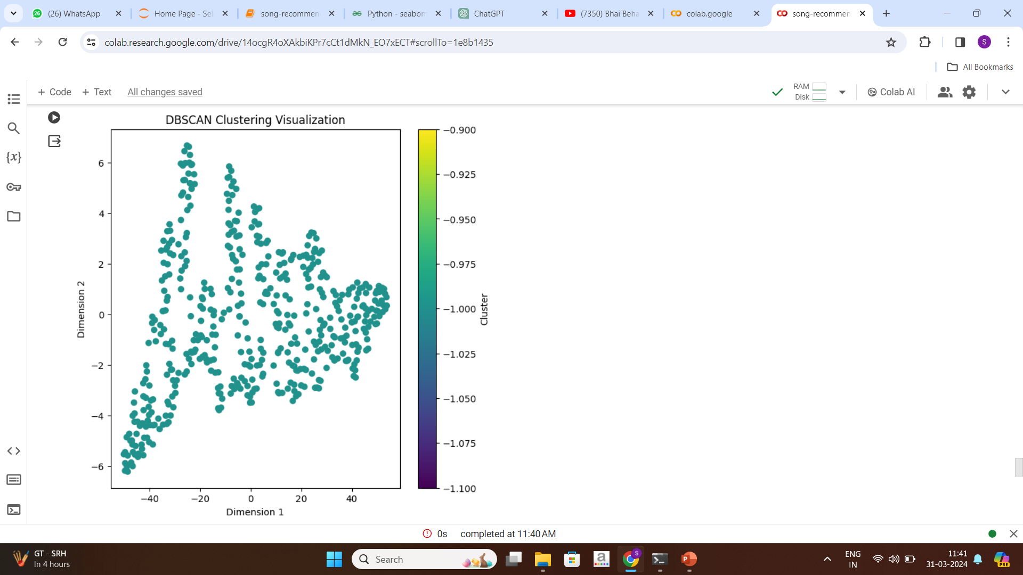
DB-SCAN:
DBSCAN also produces more reasonable results than k-means across a variety of different distributions. Below figure illustrates the fact:

Slide 17
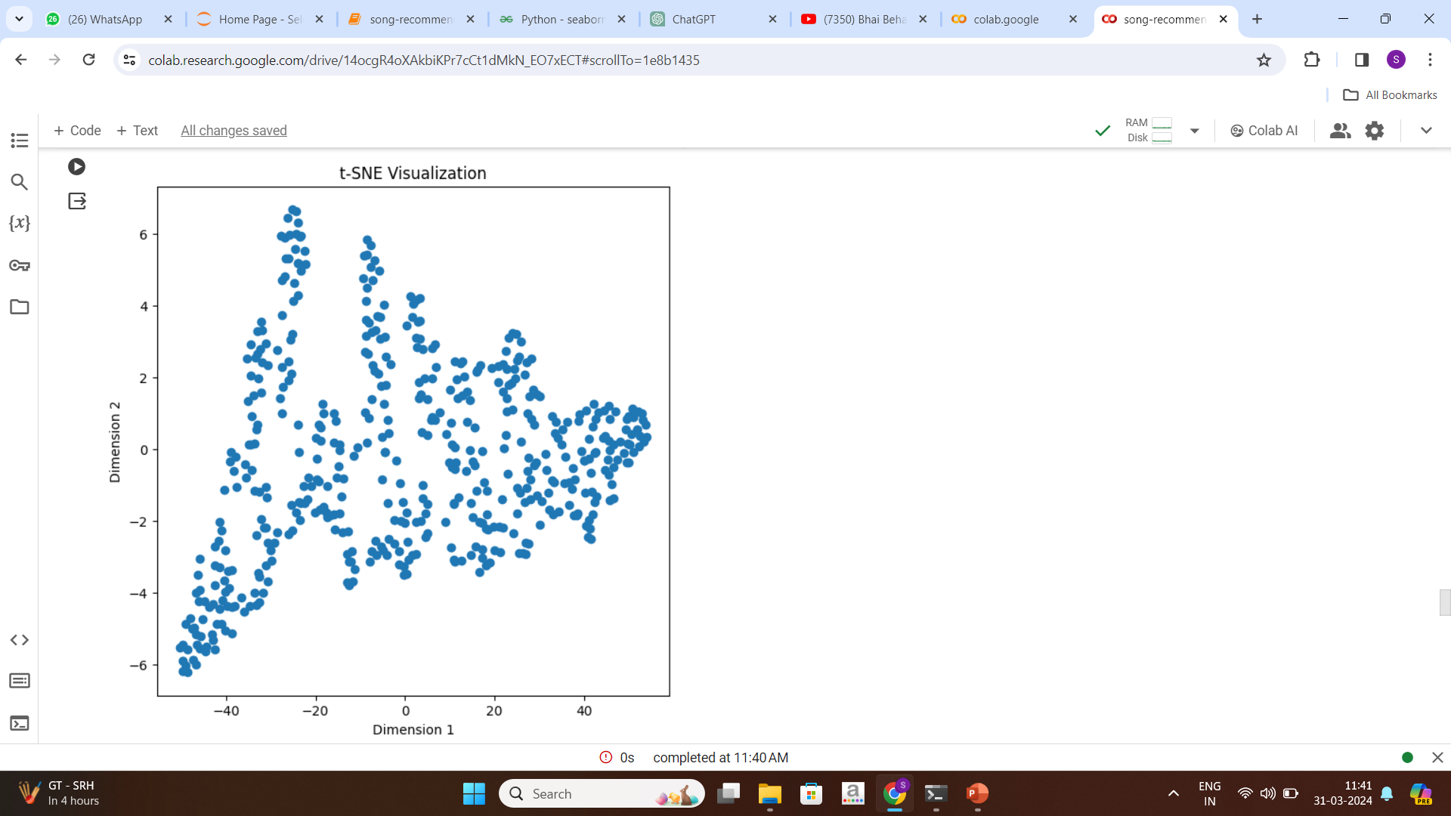
TSNE:
TSNE is a powerful tool in song recognition system projects for dimensionality reduction, visualization, clustering analysis, preprocessing, and feature engineering, ultimately leading to better understanding and utilization of song data.

Slide 18
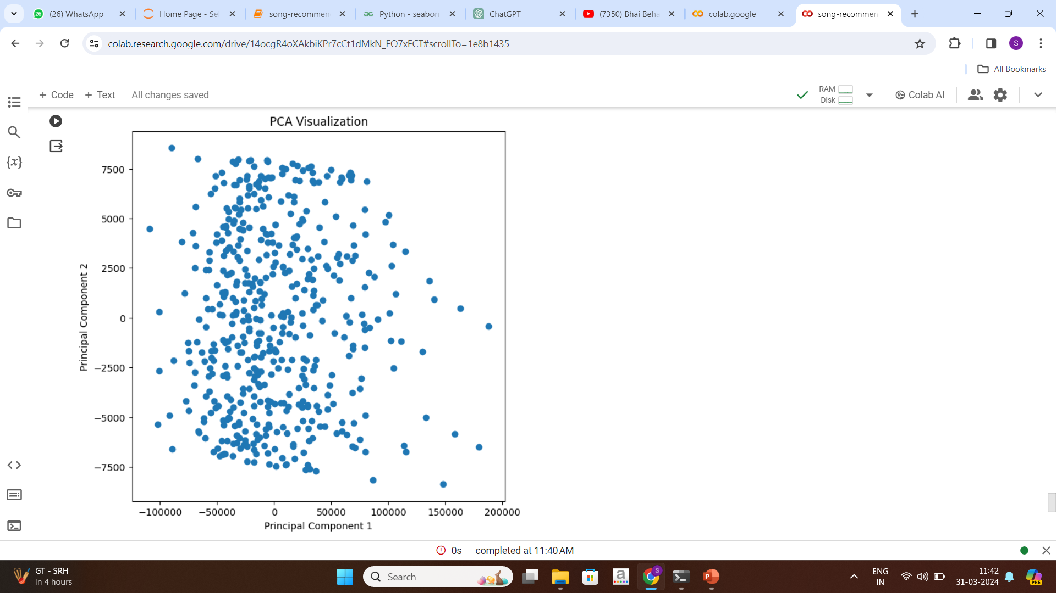
PCA:
PCA plays a crucial role in song recognition system by facilitating dimensionality reduction, noise reduction, visualization, feature engineering, and preprocessing for machine learning, ultimately leading to better
understanding and utilization of song data.

Slide 19
Using A Model For Deployment From Model Evaluation:
Real-time Clustering: DBSCAN is well-suited for deployment in real-time systems due to its efficiency in handling large datasets and its ability to adapt to changes in data distribution.
Automated Noise Handling: This automated noise handling capability simplifies the deployment process and ensures reliable clustering results even in the presence of outliers.
Interpretability and Visualization: DBSCAN produces clusters with clear boundaries, making it easier to interpret and visualize the results. This is beneficial for stakeholders and end-users who need to understand and make decisions based on the clustered data.
Parameter Stability: DBSCAN has fewer hyperparameters compared to some other clustering algorithms, such as the number of clusters in k-means. Once the appropriate values for epsilon (eps) and minimum samples (min_samples) are determined through model evaluation, they tend to remain stable over time and across different datasets.

Slide 20
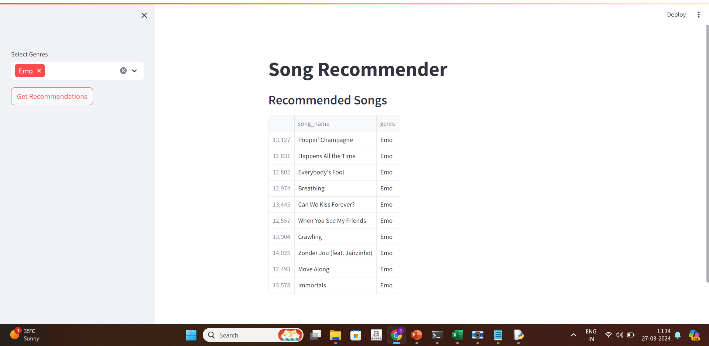
Model Deployment using streamlit:
Deploying a song recognition system using Streamlit involves creating a web application that users can interact with to input song features or upload audio files and receive recognition results.

Slide 21
Challenges faced:
High-Dimensional Data: Song data often contains a high number of features, such as audio features (tempo, pitch, timbre) and metadata (artist, genre, release year).
Data Quality and Consistency: Song data from different sources may have inconsistencies, missing values, or errors.
Scalability: As the song database grows, clustering algorithms must scale to handle the increasing volume of data efficiently.

Slide 22
Thank you.

